Slide 1

Image courtesy of NASA/GSFC

Slide 2
Climate Change and Plant Stress
Eugene S. Takle
Professor
Department of Agronomy
Department of Geological and Atmospheric Science
Director, Climate Science Program
Iowa State University
Ames, IA 50011
Center for Plant Stress
Iowa State University
5 October 2012

Slide 3
Outline
Scientific evidence for global climate change
Projected changes in US climate
Changes of importance to agricultural plants
Recent trends in Iowa’s climate and producer adaptation
What about the future: droughts or floods?

Slide 4
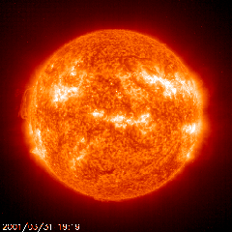
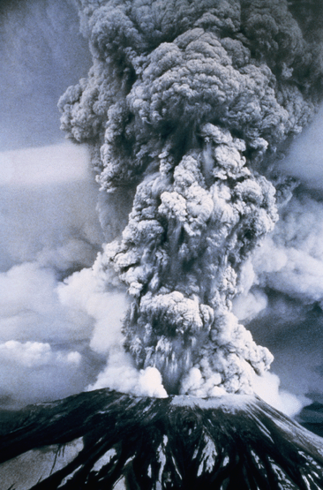
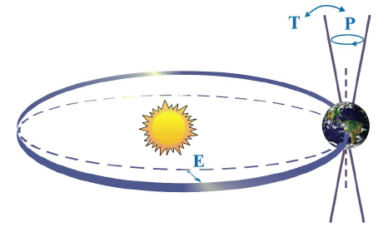

Natural factors affect climate
Variations in the energy
received from the sun
Variations in the Earth's orbit
(Milankovic effect)
Stratospheric
aerosols from
energetic
volcanic eruptions
Chaotic interactions in
the Earth's climate
(for example, El Nino, NAO)
Don Wuebbles

Slide 5
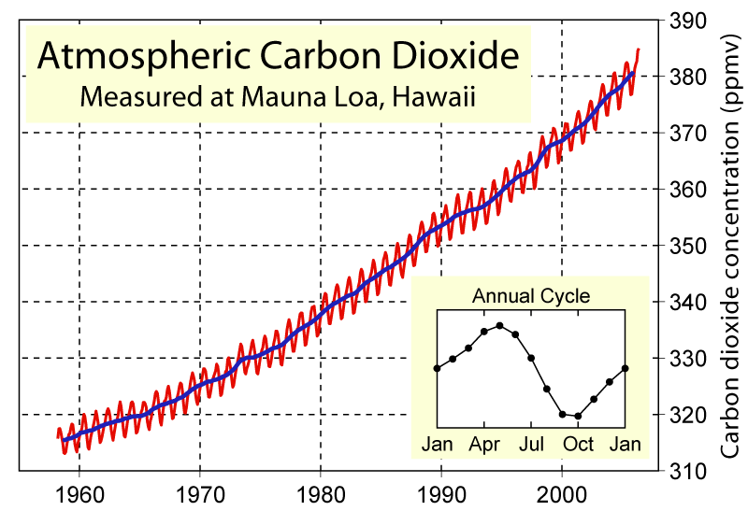
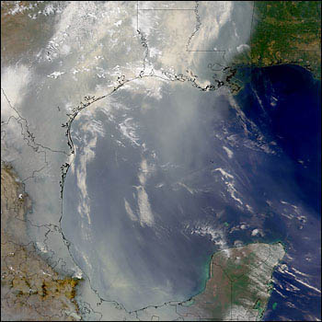
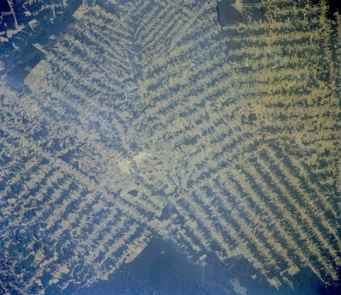
Non-natural mechanisms
Changes in atmospheric concentrations of radiatively important gases
Changes in aerosol particles from burning fossil fuels and biomass
Changes in the reflectivity (albedo) of the Earth’s surface
Don Wuebbles

Slide 6
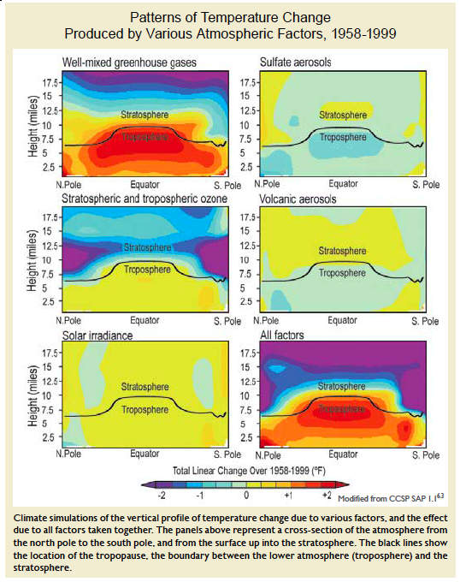
Warming of the Lower and Upper Atmosphere Produced by Natural and Human Causes
Karl, T. R., J. M. Melillo, and T. C. Peterson, (eds.), 2009: Global Climate Change Impacts in the United States. Cambridge University Press, 2009, 196pp.

Slide 7
Warming of the Lower and Upper Atmosphere Produced by Natural and Human Causes
Note that greenhouse gases have a unique temperature signature, with strong warming in the upper troposphere, cooling in the lower stratosphere and strong warming at the surface over the North Pole. No other warming factors have this signature.
Karl, T. R., J. M. Melillo, and T. C. Peterson, (eds.), 2009: Global Climate Change Impacts in the United States. Cambridge University Press, 2009, 196pp.

Slide 8
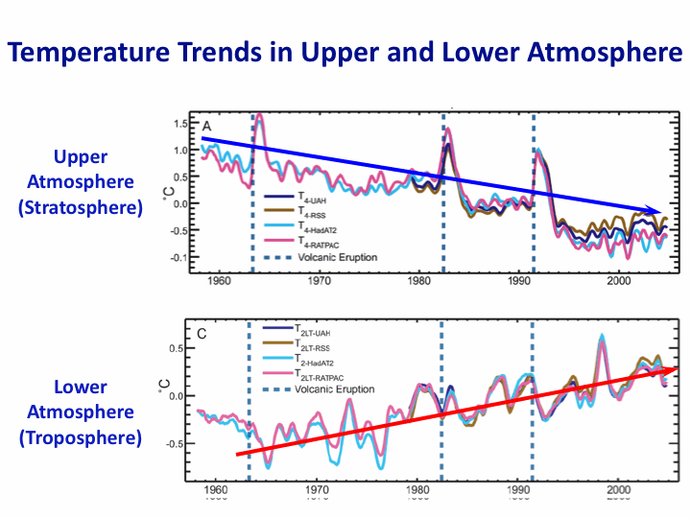
Warming of the Lower and Upper Atmosphere Produced by Natural and Human Causes
Note that greenhouse gases have a unique temperature signature, with strong warming in the upper troposphere, cooling in the lower stratosphere and strong warming at the surface over the North Pole. No other warming factors have this signature.
Karl, T. R., J. M. Melillo, and T. C. Peterson, (eds.), 2009: Global Climate Change Impacts in the United States. Cambridge University Press, 2009, 196pp.

Slide 9
Warming of the Lower and Upper Atmosphere Produced by Natural and Human Causes
Note that greenhouse gases have a unique temperature signature, with strong warming in the upper troposphere, cooling in the lower stratosphere and strong warming at the surface over the North Pole. No other warming factors have this signature.

Slide 10
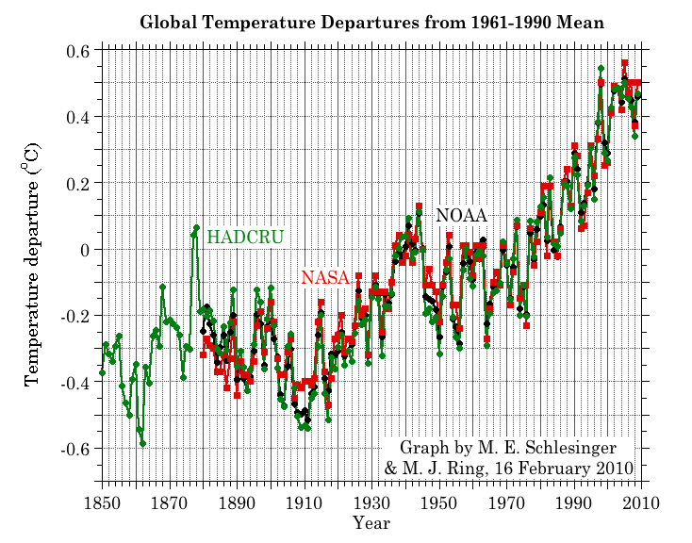
Three separate analyses of the temperature record – Trends are in close agreement
2010
2011
2010 tied 2005 as the warmest year on record since 1880

Slide 11
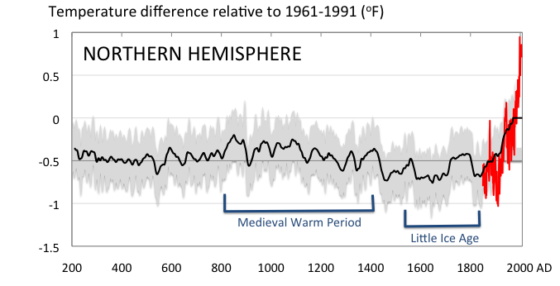
Conditions today are unusual in the context of the last 2,000 years …
Don Wuebbles

Slide 12
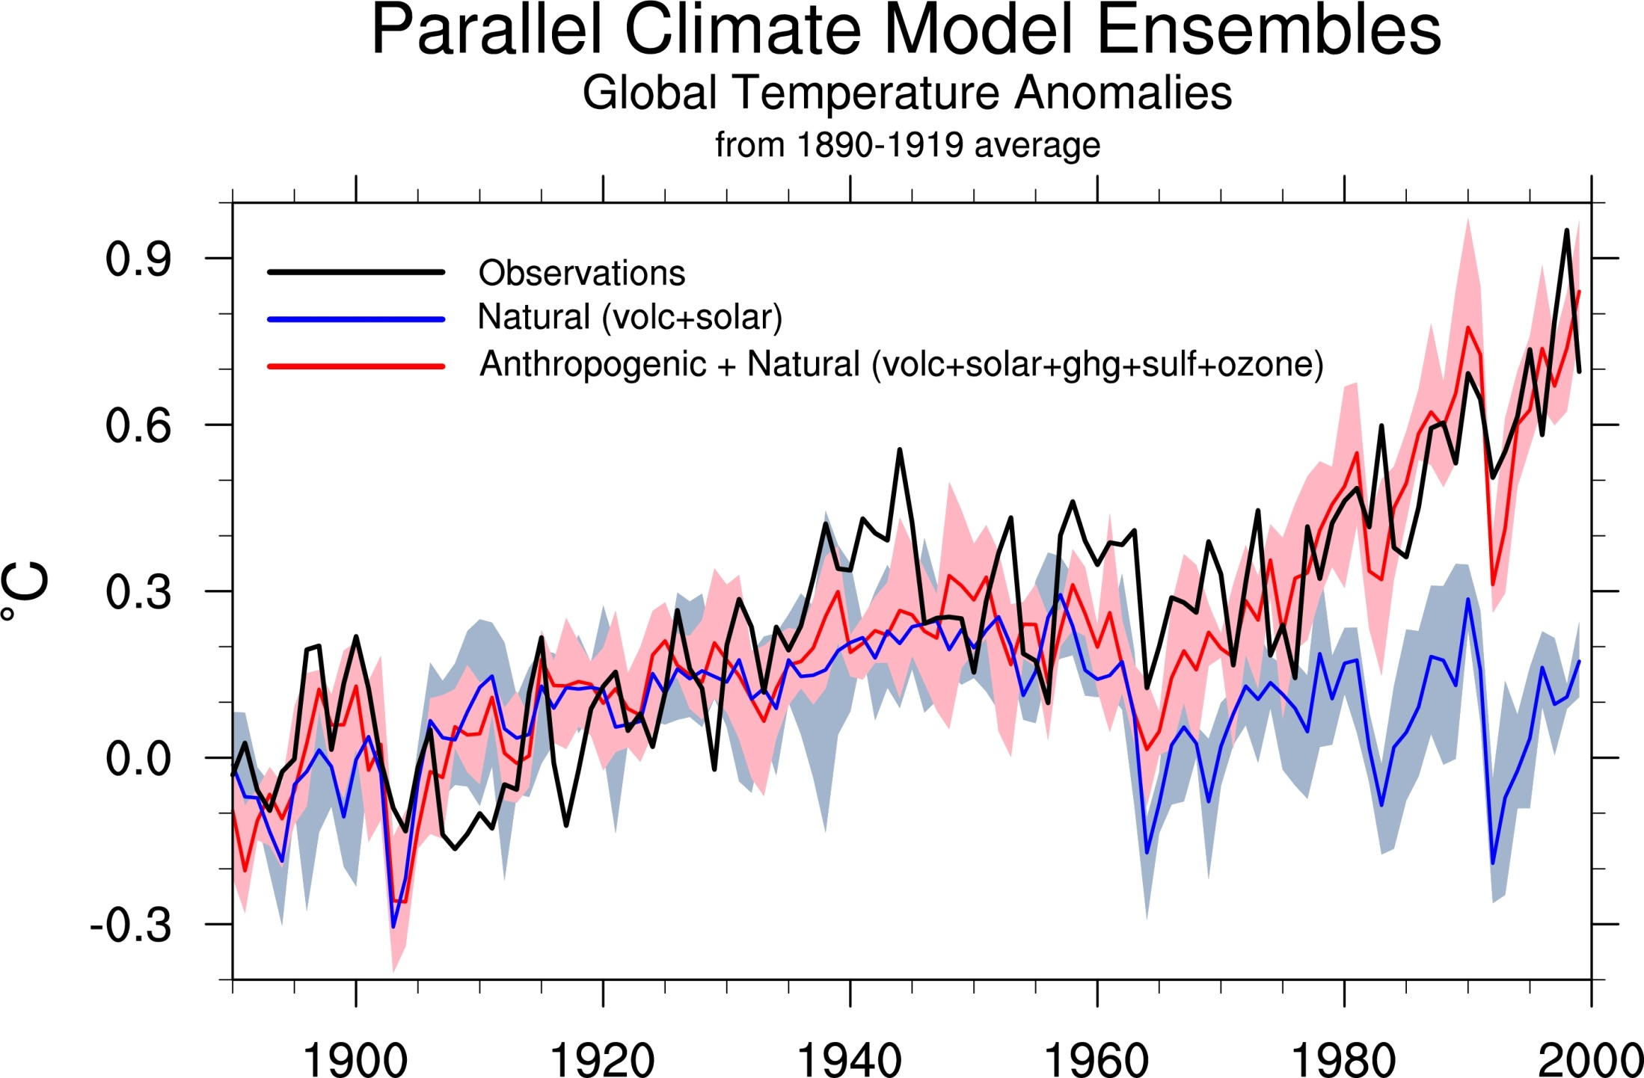
Climate models: Natural processes do not account for
observed 20th century warming after 1965
Don Wuebbles

Slide 13
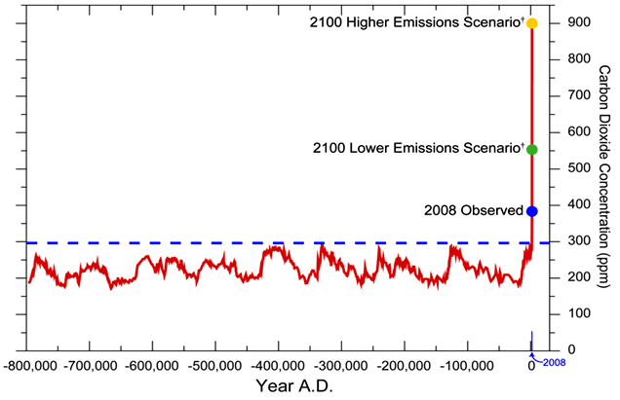
We have Moved Outside the Range of Historical Variation
800,000 Year Record of Carbon Dioxide Concentration
Don Wuebbles

Slide 14
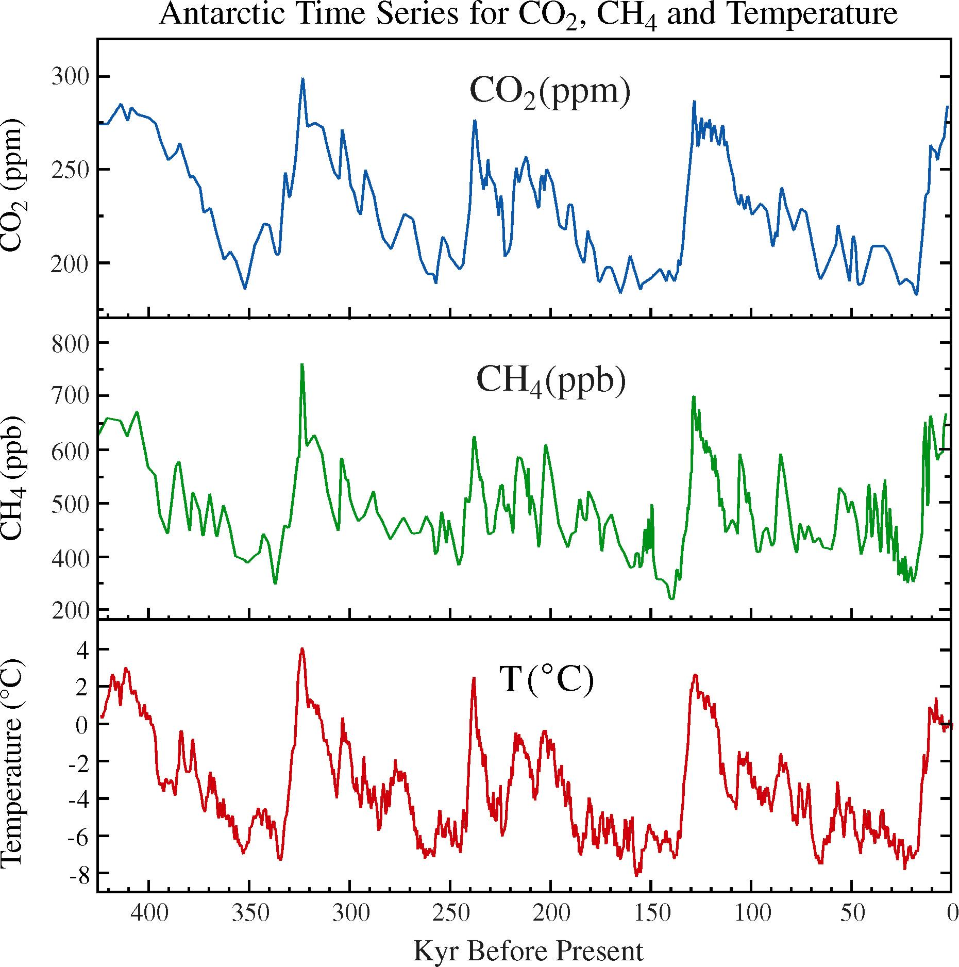
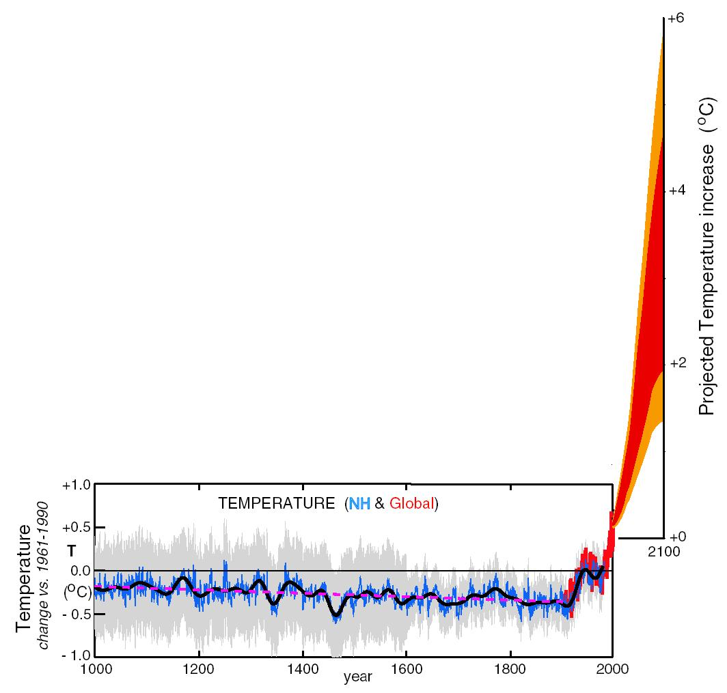
What can we expect in the future?
Don Wuebbles

Slide 15
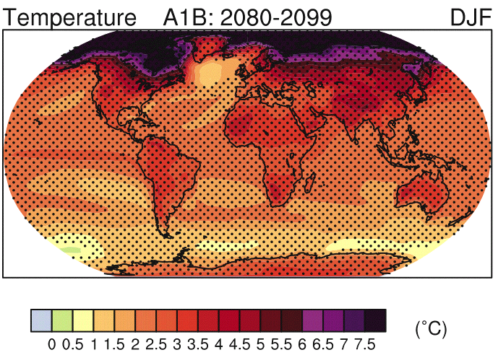
IPCC 2007

Slide 16
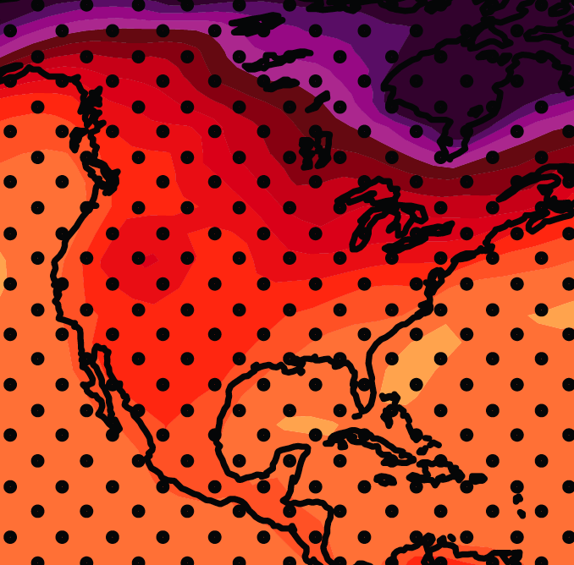
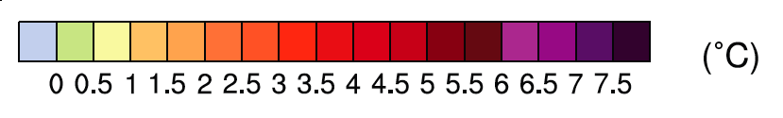
December-January-February Temperature Change
7.2ºF
6.3ºF
A1B Emission Scenario
2080-2099 minus1980-1999

Slide 17
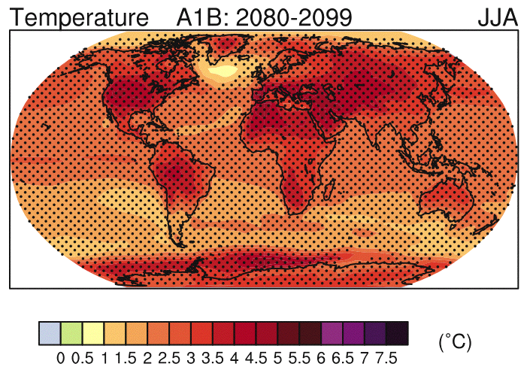
IPCC 2007

Slide 18
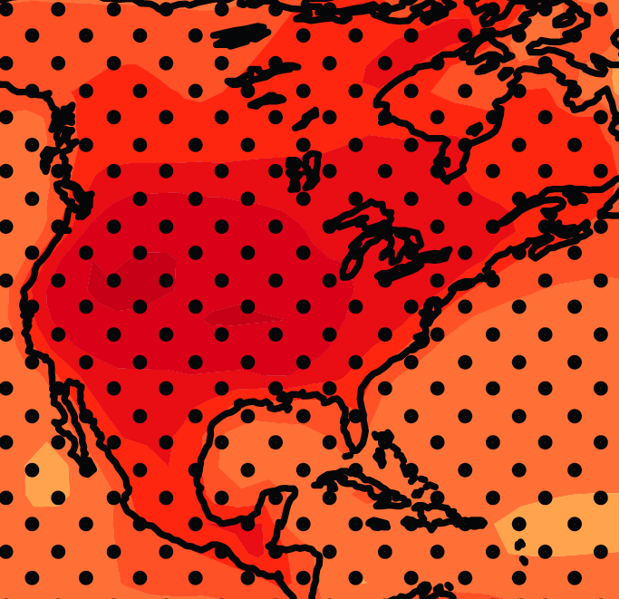
June-July-August Temperature Change
4.5ºF
5.4ºF
A1B Emission Scenario
2080-2099 minus1980-1999

Slide 19
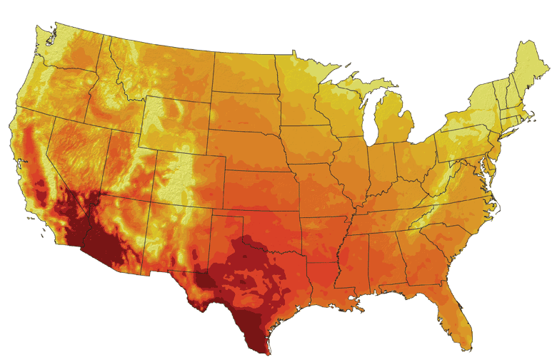
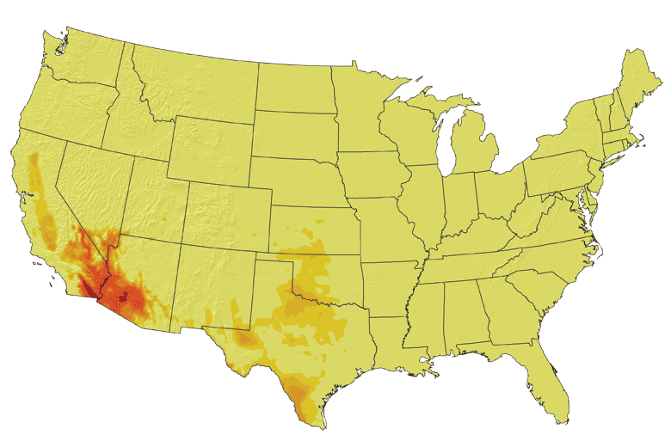
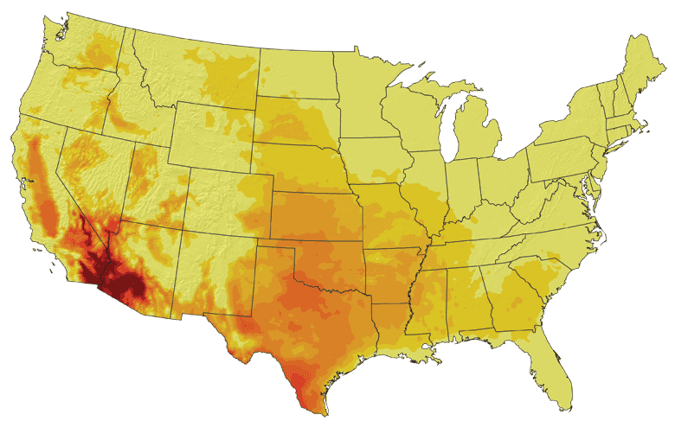
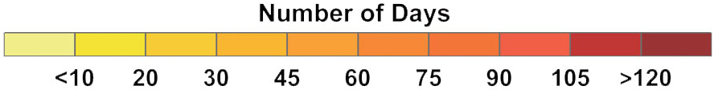
Increases in very high temperatures will have
wide-ranging effects
Higher Emissions Scenario, 2080-2099
Number of Days Over 100ºF
Recent Past, 1961-1979
Average:
30-60 days
Lower Emissions Scenario, 2080-2099
Average:
10-20 days
Don Wuebbles

Slide 20
Increases in very high temperatures will have
wide-ranging effects
Higher Emissions Scenario, 2080-2099
Number of Days Over 100ºF
Recent Past, 1961-1979
Average:
30-60 days
Current Des Moines average is < 1.4 days per year over 100ºF
Lower Emissions Scenario, 2080-2099
Average:
10-20 days
Don Wuebbles

Slide 21
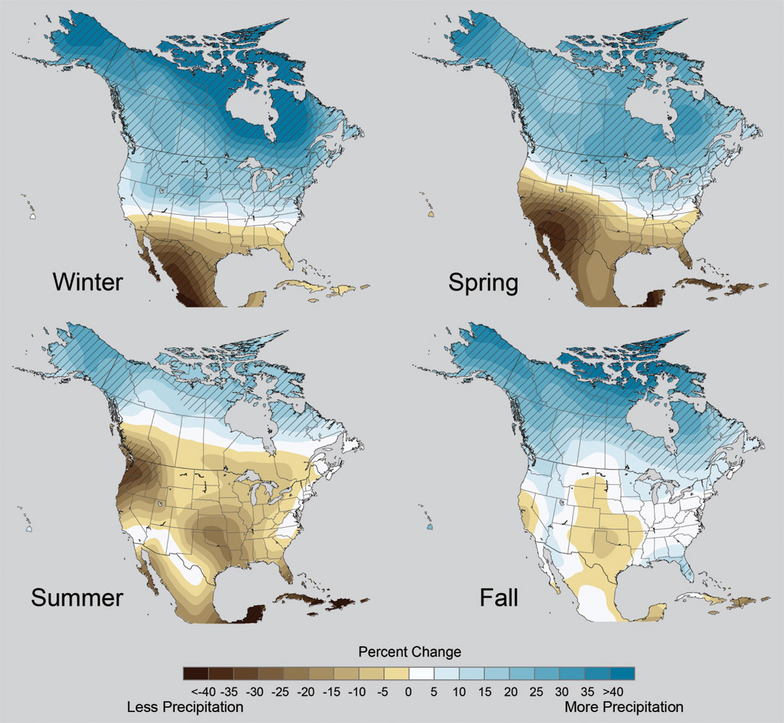
Projected Change in Precipitation: 2081-2099
Midwest: Increasing winter and spring precipitation, with drier summers
More frequent and intense periods of heavy rainfall
Unstippled regions indicate reduced confidence
Relative to 1960-1990
NOTE: Scale Reversed

Slide 22
Extreme weather events become more common
Events now considered rare will become commonplace.
Heat waves will likely become longer and more severe
Droughts are likely to become more frequent and severe in some regions
Likely increase in severe thunderstorms (and perhaps in tornadoes).
Winter storm tracks are shifting northward and the strongest storms are likely to become stronger and more frequent.
Don Wuebbles
Notes:
Shown here is the frequency at the end of the century of what we consider now to be a 20 year heat wave. Instead of once every 20 years, these temperatures would be experienced every other year or so over most of the continental US in this business as usual scenario.

Slide 23
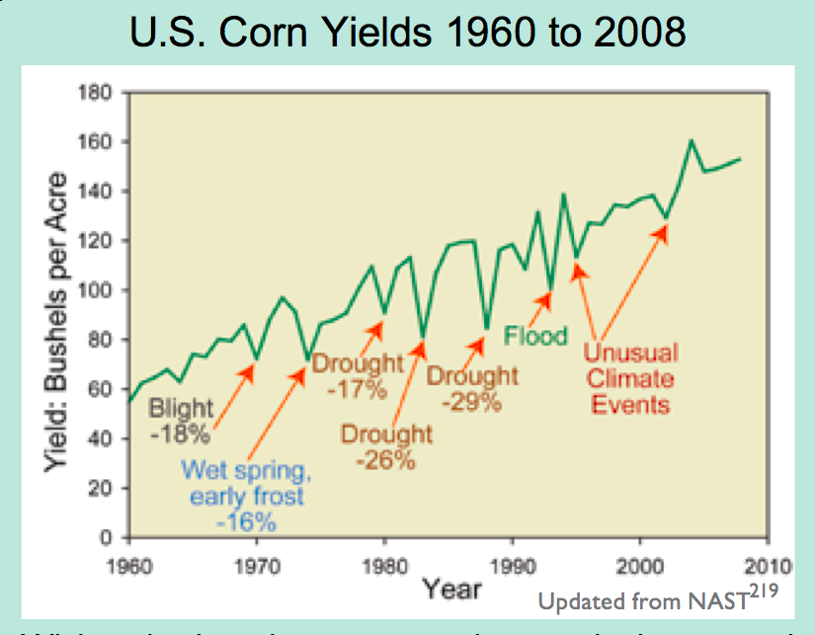
Extreme Events are Usually Detrimental

Slide 24
Key Messages from
The 2008 USGCRP
Synthesis and
Assessment
Product 4.3
(now being updated by the National Climate Assessment)

Slide 25
Key Messages from the 2008 USGCRP SAP 4.3
Climate changes – temperature increases, increasing CO2 levels, and altered patterns of precipitation – are already affecting U.S. water resources, agriculture, land resources, and biodiversity
Climate change will continue to have significant effects on these resources over the next few decades and beyond
With increased CO2 and temperature, the life cycle of grain and oilseed crops will likely progress more rapidly. But, as temperature rises, these crops will increasingly begin to experience failure, especially if climate variability increases and precipitation lessens or becomes more variable.
The marketable yield of many horticultural crops – e.g., tomatoes, onions, fruits – is very likely to be more sensitive to climate change than grain and oilseed crops.

Slide 26
Key Messages from the 2008 USGCRP SAP 4.3
Climate change is likely to lead to a northward migration of weeds. Many weeds respond more positively to increasing CO2 than most cash crops, particularly C3 “invasive” weeds. Recent research also suggests that glyphosate, the most widely used herbicide in the United States, loses its efficacy on weeds grown at the increased CO2 levels likely in the coming decades.
Disease pressure on crops will likely increase with earlier springs and warmer winters, which will allow proliferation and higher survival rates of pathogens and parasites. Regional variation in warming and changes in rainfall will also affect spatial and temporal distribution of disease.
Projected increases in temperature and a lengthening of the growing season will likely extend forage production into late fall and early spring, thereby decreasing need for winter season forage reserves. However, these benefits will very likely be affected by regional variations in water availability.
Climate change-induced shifts in plant species are already under way in rangelands. Establishment of perennial herbaceous species is reducing soil water availability early in the growing season.

Slide 27
Changes in Climate Relevant to Plant Stress

Slide 28
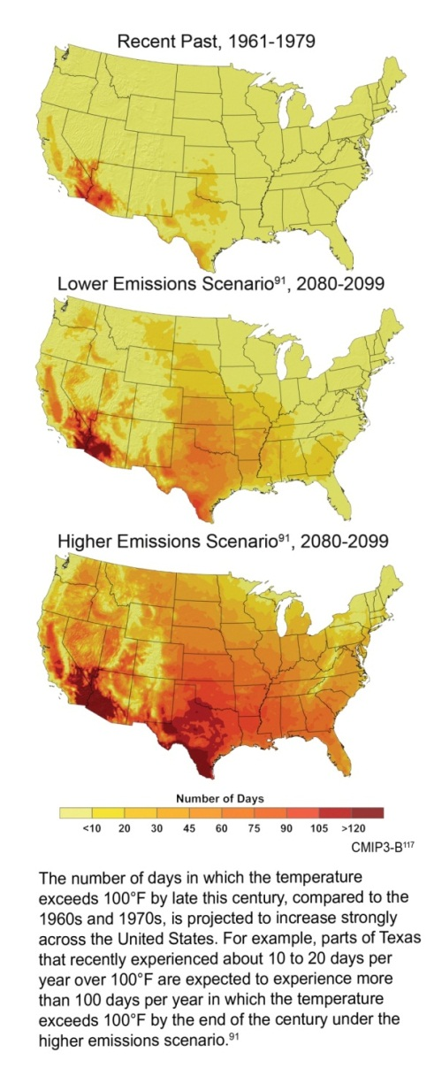
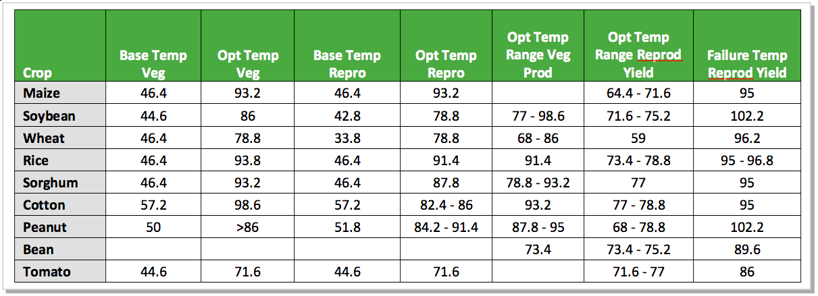
Crop Yield and Grain Quality are Compromised by Temperature Increase
Days/Yr with T>100ºF
Rising daily maximum temperatures increase the likelihood of extended periods with temperatures above the failure point for reproduction (grain production)
Rising nighttime temperatures (ºF) decrease the quality of grain (corn)

Slide 29
Percent Changes in Crop Yield with
Projected Changes in Annual Mean Temperature
(not water or nutrient limited)
California Central Valley
Lee, J., S. DeGryze, and J. Six. 2011. Effect of climate change on field crop production in the California’s Central Valley. Climatic Change. 109(Suppl):S335-S353

Slide 30
Projected Yield Changes for California Crops
Simulations using the DAYCENT model while ensuring water supplies and nutrients were maintained at adequate levels under low (B1) and medium-high (A2) emissions scenarios.
Lee, J., S. DeGryze, and J. Six. 2011. Effect of climate change on field crop production in the California’s Central Valley. Climatic Change. 109(Suppl):S335-S353

Slide 31
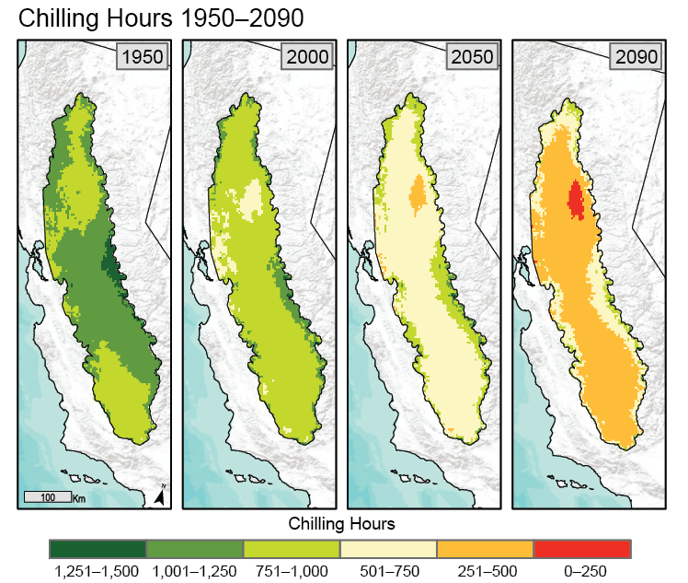
Changes in Climate Relevant to Plant Stress
A2 Climate scenario
Chilling hours for fruit production
Number of chilling hours is projected to rapidly decrease over the next 100 years.
Trees and grapes differ in their chilling requirements:
grapes: 90
peaches 225
apples 400
cherries 900

Slide 32
Can we trust climate models to project a future climate in the Midwest?
NASA GISS model from 1988 projected for Iowa:
Longer growing season
Winters will warm more than summers
Nights will warm more than days
Precipitation will increase
Shift in precipitation seasonality toward more in the first half year and less in the second half
After 21 years how well have they done?
Takle, E. S., and S. Zhong, 1991: Iowa’s climate as projected by the global climate model of the Goddard Institute for Space Studies for a doubling of atmospheric carbon dioxide. Journal of the Iowa Academy of Science 98 (4), 153-158.

Slide 33
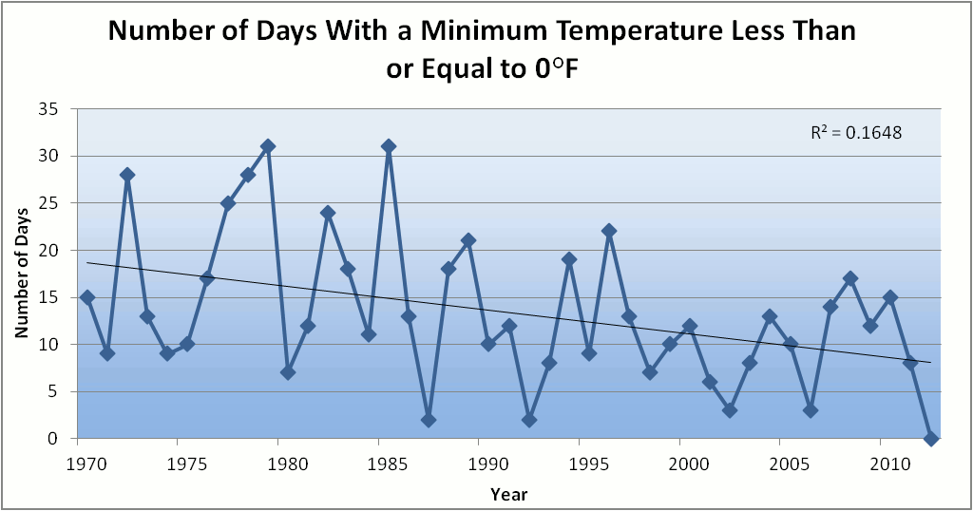
Des Moines Airport Data
Caution: Not corrected for urban heat island effects

Slide 34
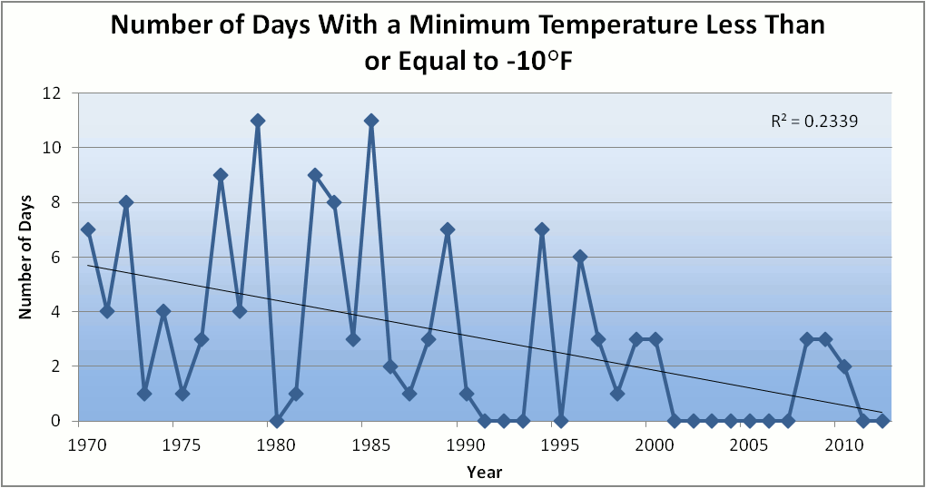
Des Moines Airport Data
Caution: Not corrected for urban heat island effects

Slide 35
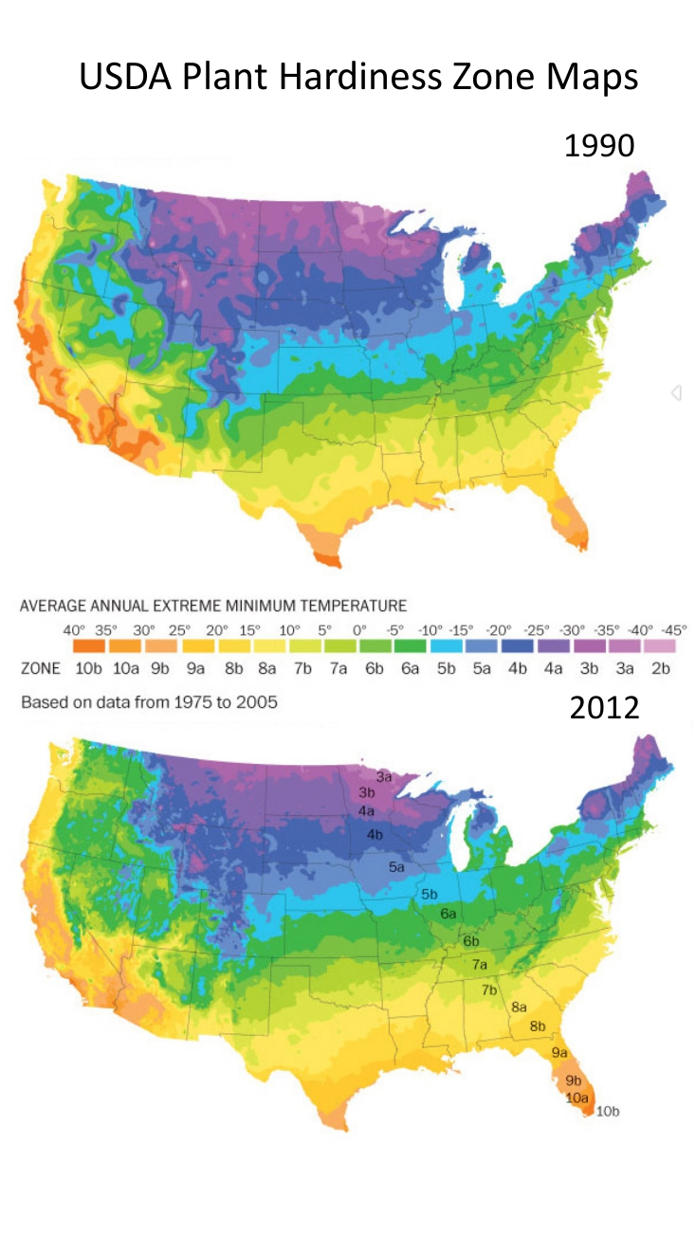
Winter Temperatures are Rising, Fewer Extreme Cold Events
Des Moines Data
Des Moines Data

Slide 36
Iowa State-Wide Average Data

Slide 37
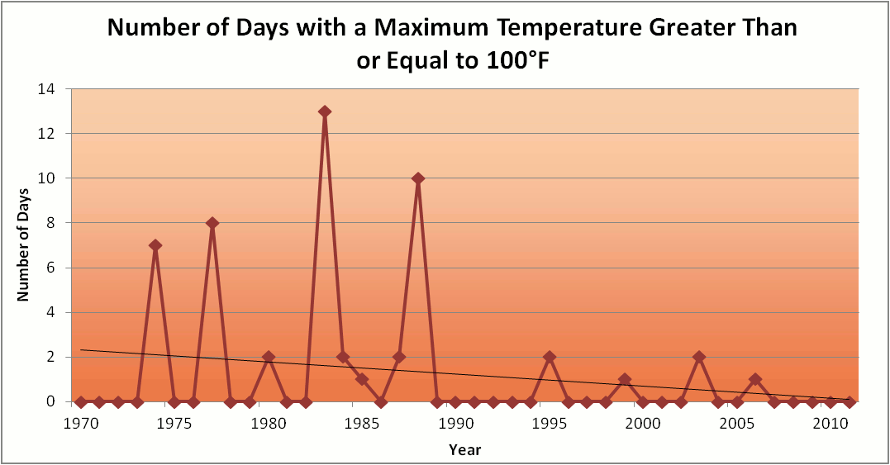
Des Moines Airport Data
1983: 13
1988: 10
1977: 8
1974: 7
6 days ≥ 100ºF in the last 23 years

Slide 38
Des Moines Airport Data
1983: 13
8 days in 2012
1988: 10
1977: 8
1974: 7
6 days ≥ 100ºF in the last 23 years

Slide 39
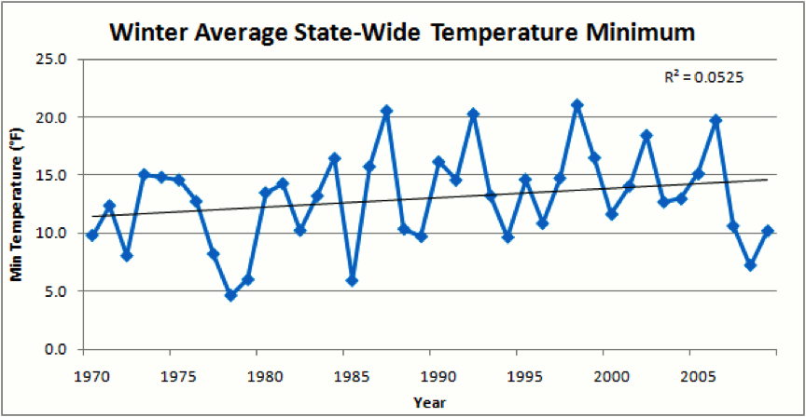
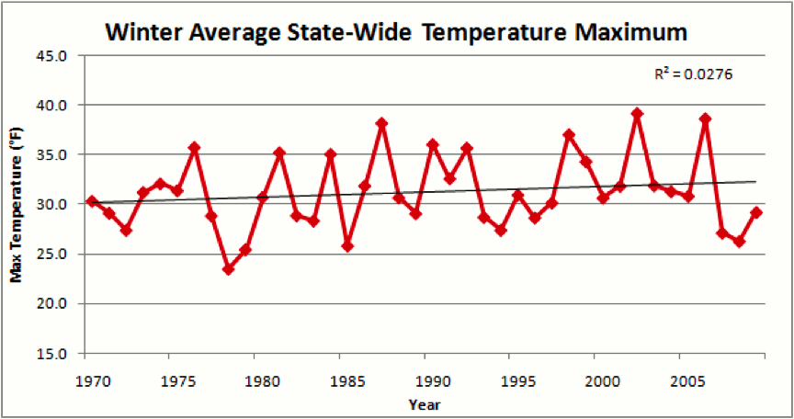
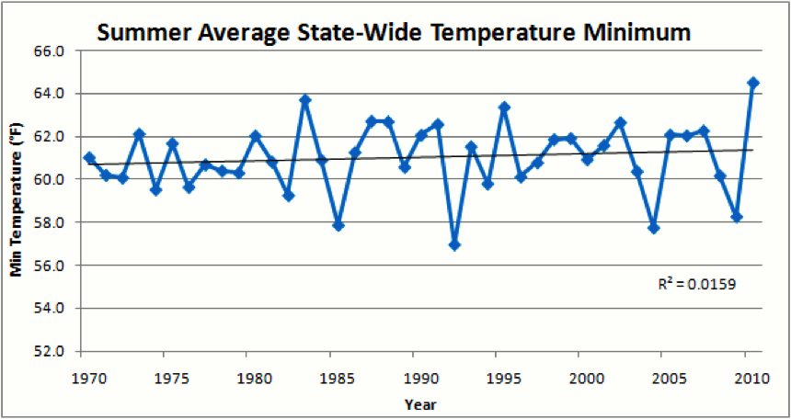
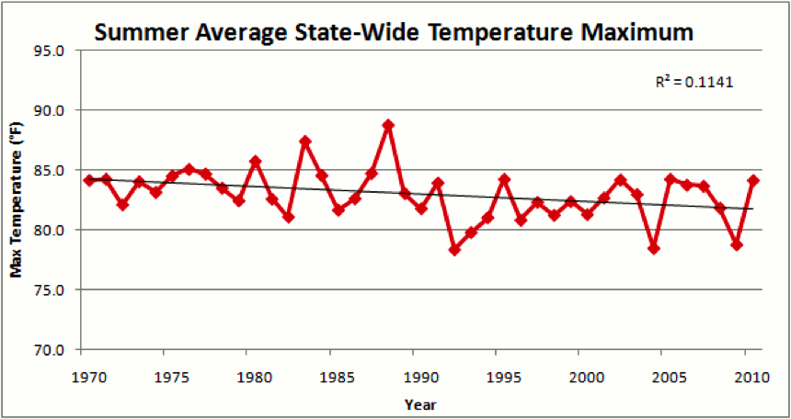

Slide 41
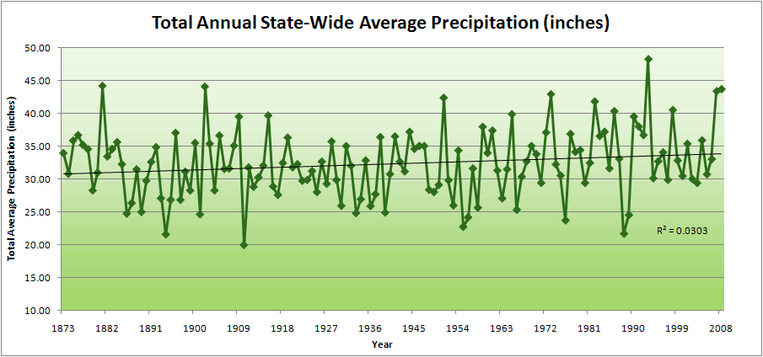
Iowa State-Wide Average Data
34.0”
10% increase
30.8”

Slide 42
Iowa State-Wide Average Data
Totals above 40”
2 years
34.0”
10% increase
30.8”

Slide 43
Iowa State-Wide Average Data
Totals above 40”
2 years
8 years
34.0”
10% increase
30.8”

Slide 44
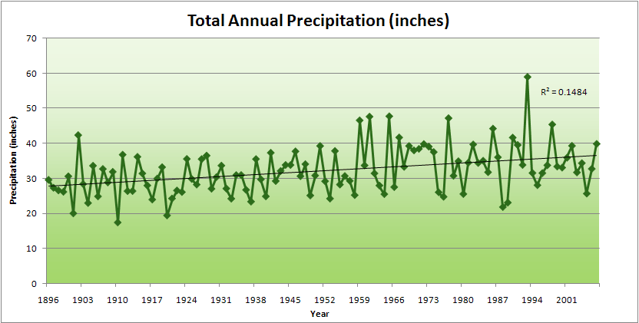
Cedar Rapids Data

Slide 45
Cedar Rapids Data
28.0”
32% increase
37.0”

Slide 46
Cedar Rapids Data
Years with more than 40 inches
11
1
28.0”
32% increase
37.0”

Slide 47
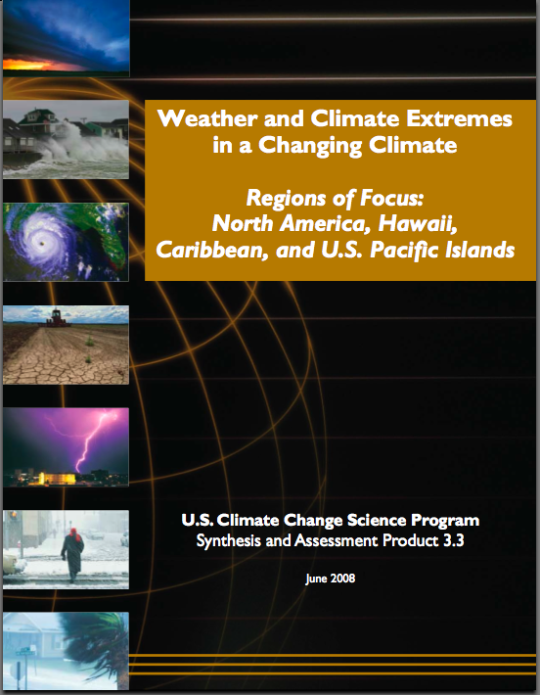
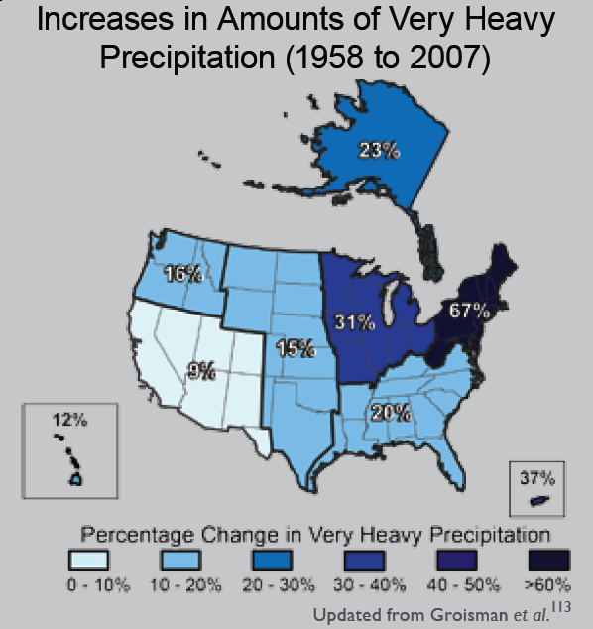
“One of the clearest trends in the United States observational record is an increasing frequency and intensity of heavy precipitation events… Over the last century there was a 50% increase in the frequency of days with precipitation over 101.6 mm (four inches) in the upper midwestern U.S.; this trend is statistically significant “
Karl, T. R., J. M. Melillo, and T. C. Peterson, (eds.), 2009: Global Climate Change Impacts in the United States. Cambridge University Press, 2009, 196pp.

Slide 48
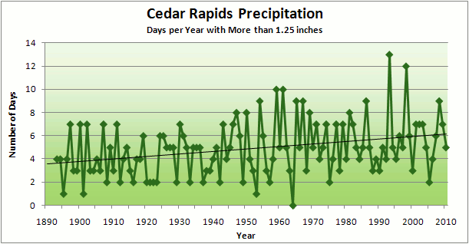
Cedar Rapids Data
3.6 days
67% increase
6.0 days

Slide 49
Cedar Rapids Data
Number of Years with More than 8 Occurrences
0
9
3.6 days
67% increase
6.0 days

Slide 51
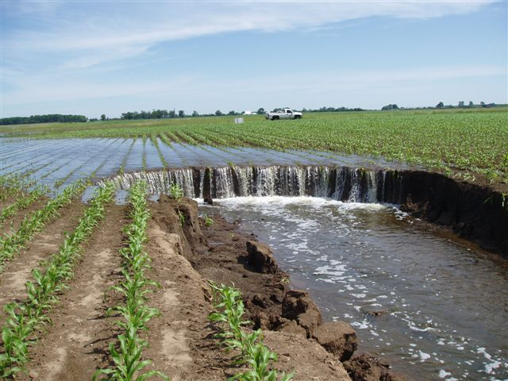
Photo courtesy of RM Cruse

Slide 52
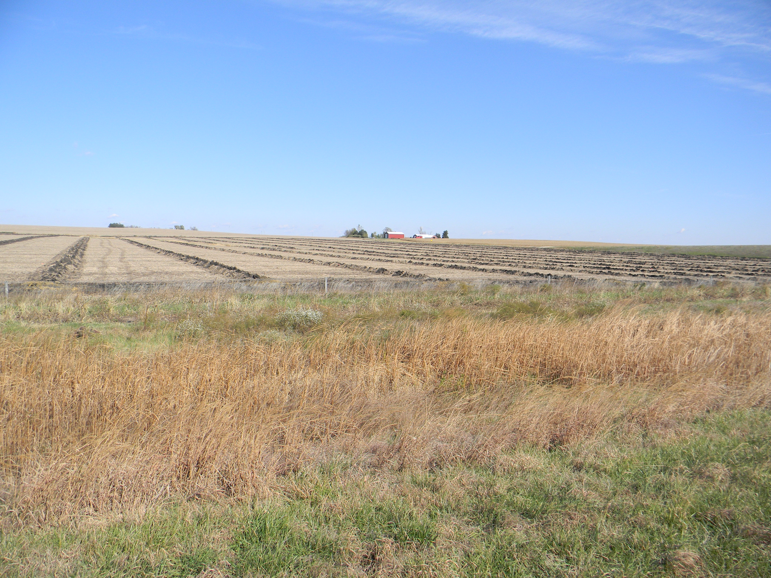

Slide 53
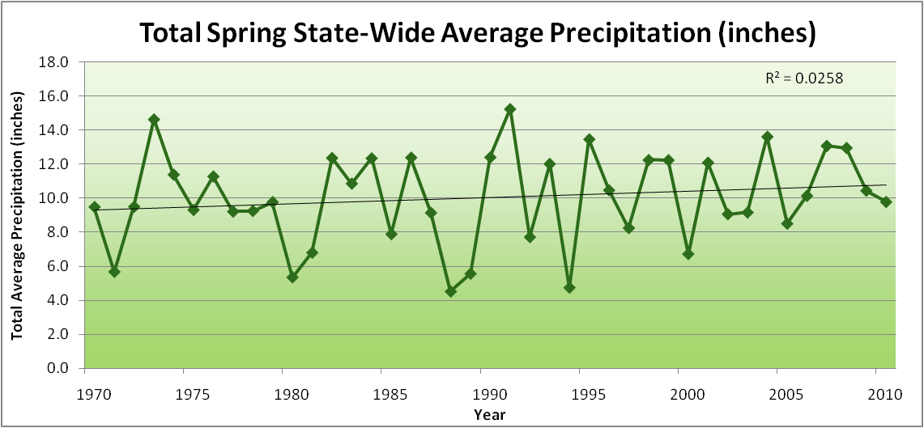
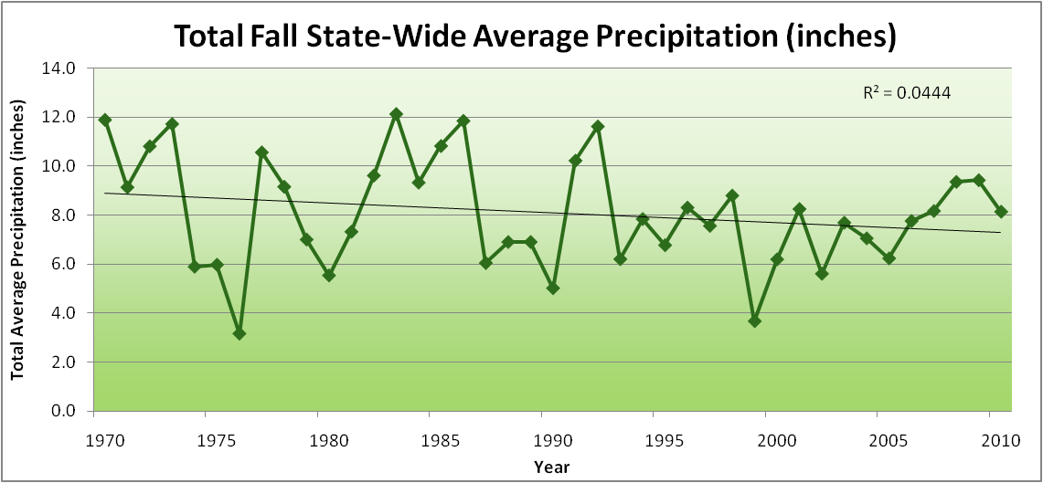
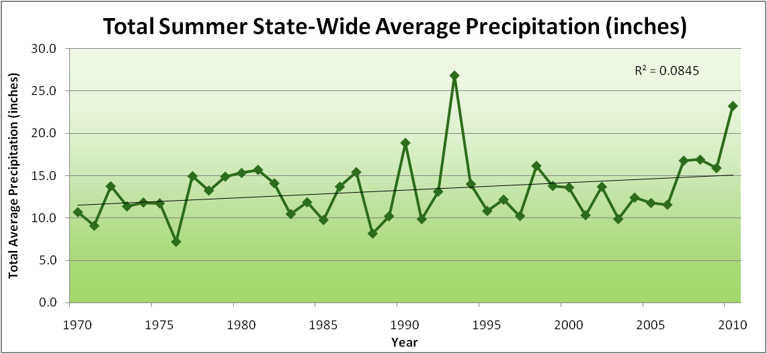
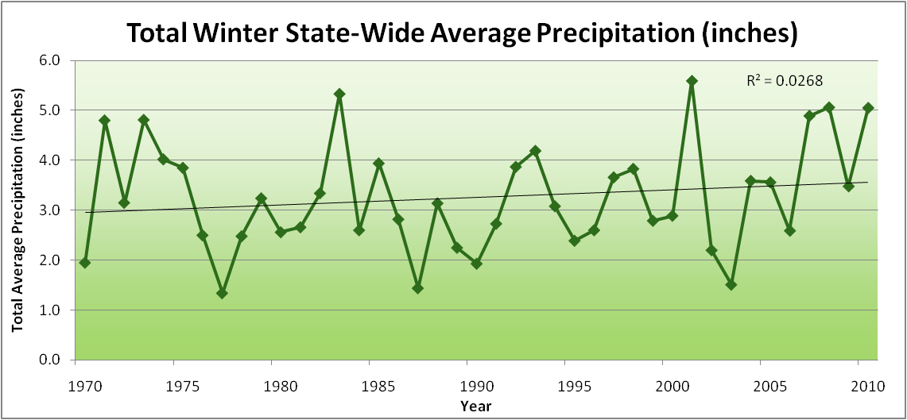
Amplification of the Seasonality of Precipitation
Spring
Fall
Summer
Winter

Slide 54
Amplification of the Seasonality of Precipitation
Spring
Fall
Summer
Winter

Slide 55
Amplification of the Seasonality of Precipitation
Spring
Fall
21.2 => 25.3 inches (22% increase)
12.1 => 10.5 inches (13% decrease)
Summer
Winter

Slide 56
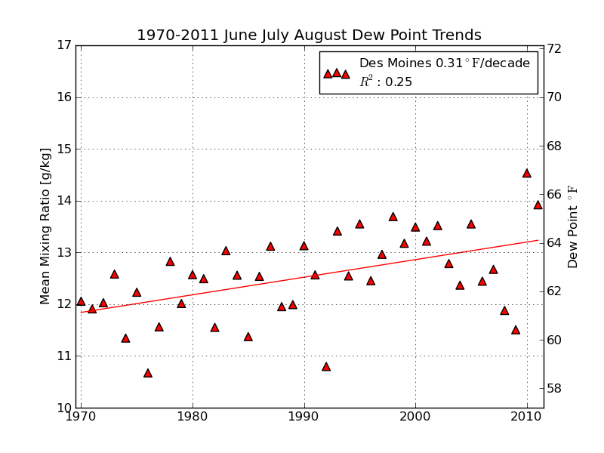
Mean Summer (JJA) Dew-Point Temperatures for Des Moines, IA
Rise of 3ºF in 42 years
12% rise in water content in 42 years

Slide 57
Can we trust climate models to project a future climate in the Midwest?
NASA GISS model from 1988 projected for Iowa:
Longer growing season (True)
Winters will warm more than summers (True)
Nights will warm more than days (True)
Precip will increase (True, but probably just lucky)
Shift in precipitation seasonality toward more in the first half year and less in the second half (True)
Overall tendencies have been correct.
Would these projections have led to visionary decisions?

Slide 58
Iowa Agricultural Producers are Adapting to Climate Change:
Longer growing season: plant earlier, plant longer season hybrids, harvest later
Wetter springs: larger machinery enables planting in smaller weather windows
More summer precipitation: higher planting densities for higher yields
Wetter springs and summers: more subsurface drainage tile is being installed, closer spacing, sloped surfaces
Fewer extreme heat events: higher planting densities, fewer pollination failures
Higher humidity: more spraying for pathogens favored by moist conditions. more problems with fall crop dry-down, wider bean heads for faster harvest due to shorter harvest period during the daytime.
Drier autumns: delay harvest to take advantage of natural dry-down conditions, thereby reducing fuel costs
HIGHER YIELDS!!
Is it genetics or climate? Likely some of each.

Slide 59
So what about droughts in the future?

Slide 60
Iowa State-Wide Average Data
Totals above 40”
2 years
8 years
34.0”
10% increase
30.8”

Slide 61
Iowa State-Wide Average Data
Totals above 40”
2 years
8 years
3 years
5 years
2012?
Totals below 25”

Slide 62
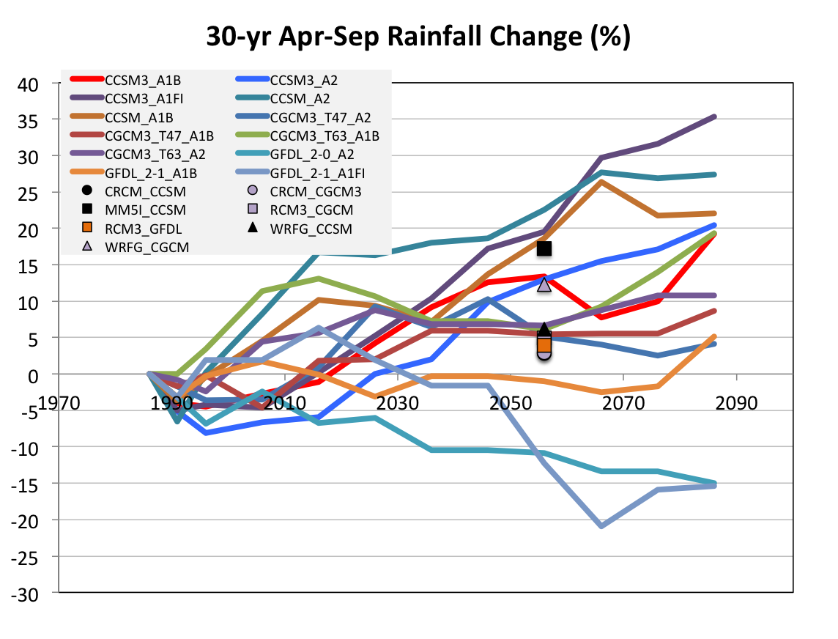
Projected Change in Growing Season Precipitation for Iowa
No change
GFDL
CJ Anderson, ISU

Slide 63
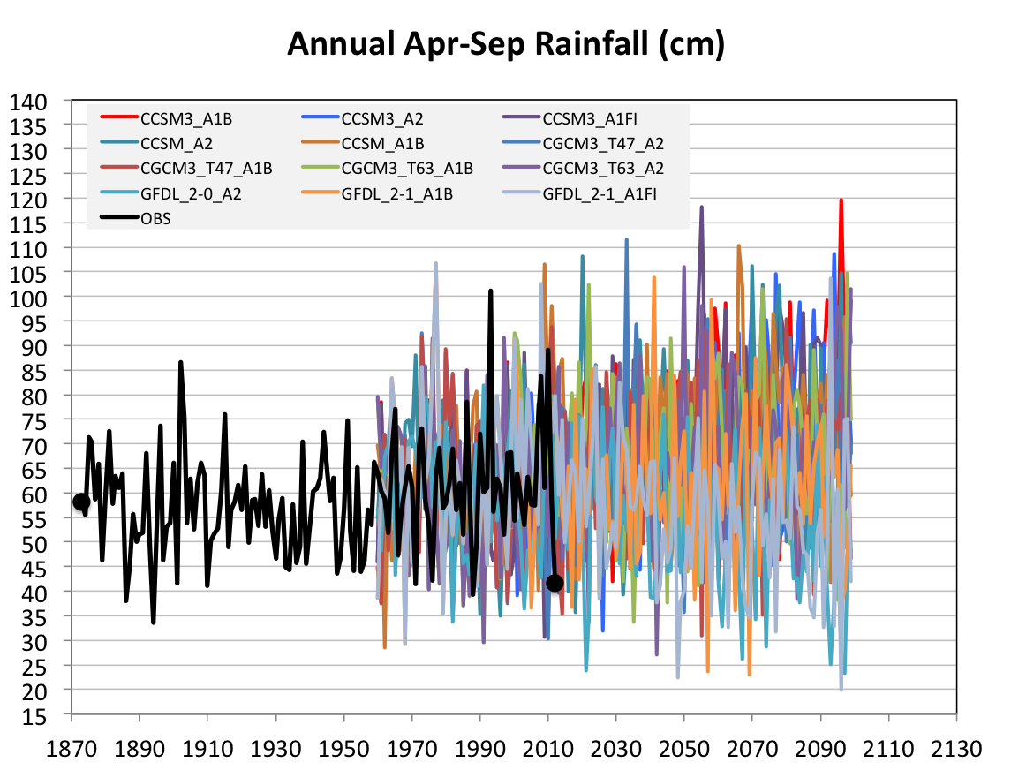
Future Variability in Growing Season Precipitation for Iowa
More extreme floods
More extreme droughts
CJ Anderson, ISU

Slide 64
Future Variability in Growing Season Precipitation for Iowa
More extreme floods
Lines drawn by eye
More extreme droughts
CJ Anderson, ISU

Slide 65
Summary
The well-documented global warming of the last 50 years cannot be explained by natural variation alone.
Both agricultural crops and non-agricultural plants are being affected by climate change, and as the climate changes further, yields will decline
Higher precipitation of the last 40 years has suppressed Iowa daily max temperatures in summer; dry summers in the future will unmask this underlying warming
Frequency of precipitation extremes has increased
Future projections indicate higher frequency of both floods and droughts

Slide 66
For More Information:
Climate Science Program
Iowa State University
http://climate.engineering.iastate.edu/
http://www.meteor.iastate.edu/faculty/takle/
gstakle@iastate.edu

